Slide 1
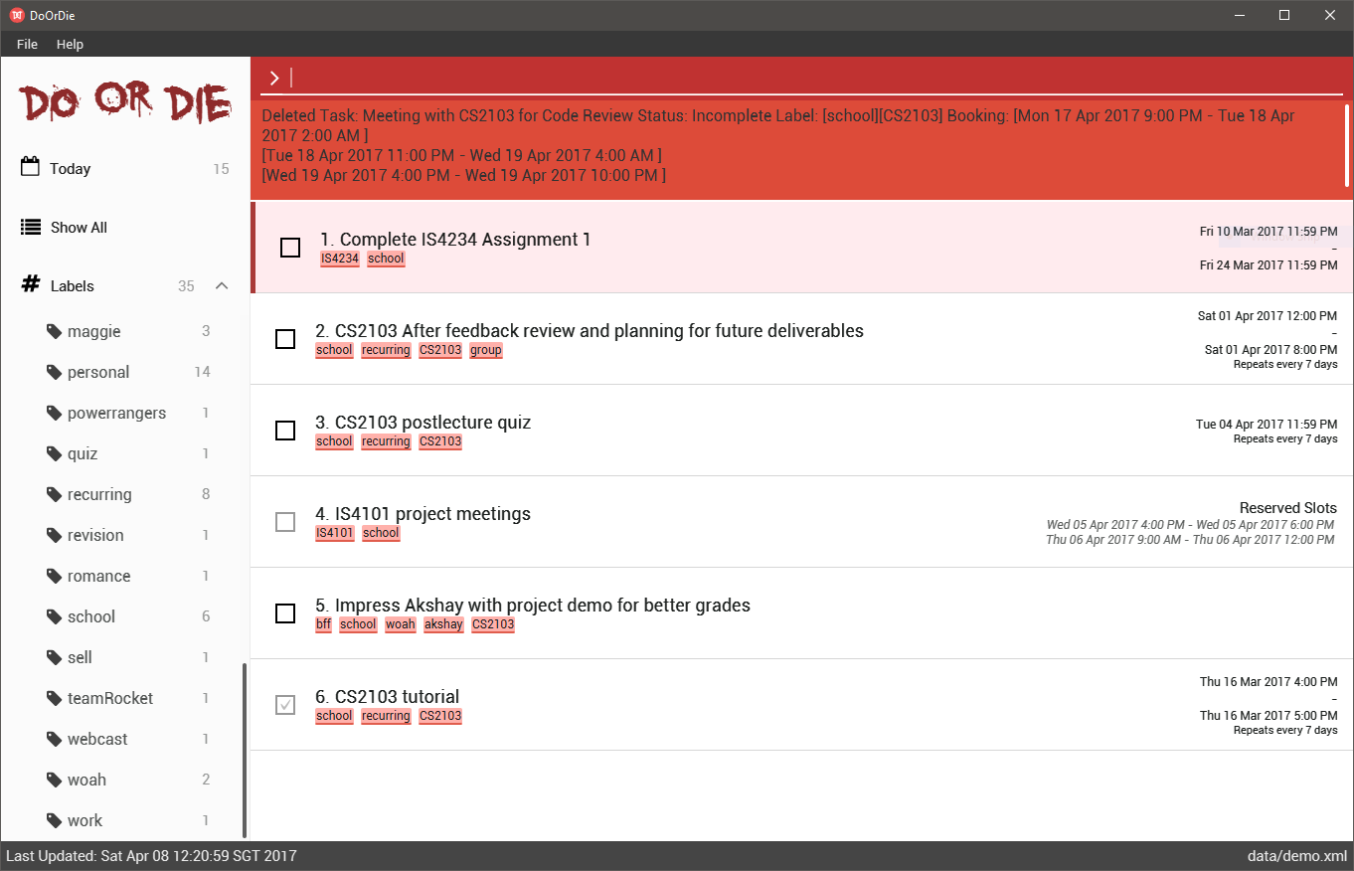
Menu bar
Command Input
Show today tasks
Results output
Show all incomplete tasks
Toggle label list
Deadline Task
Recurring Task
Individual labels and number of tasks
Booking Task
Floating Task
Task Index
Task Title
Completion status
Labels
Update status
Storage Location

